Slide 1

Stage 4 Gentle Spartans Course Designer: Jordan Rogers
Gentle Spartans is a 21 round, 105 point Comstock long course. There are 8 USPSA targets and 5 steel targets. The best two hits per target will score. Steel must fall to score. The start signal is audible.
The start position is standing anywhere within the shooting area with wrists above shoulders. Loaded firearm staged on any barrel, lying flat and unsupported with muzzle pointing downrange.
On the audible start signal, engage all targets within the shooting area.

Slide 2
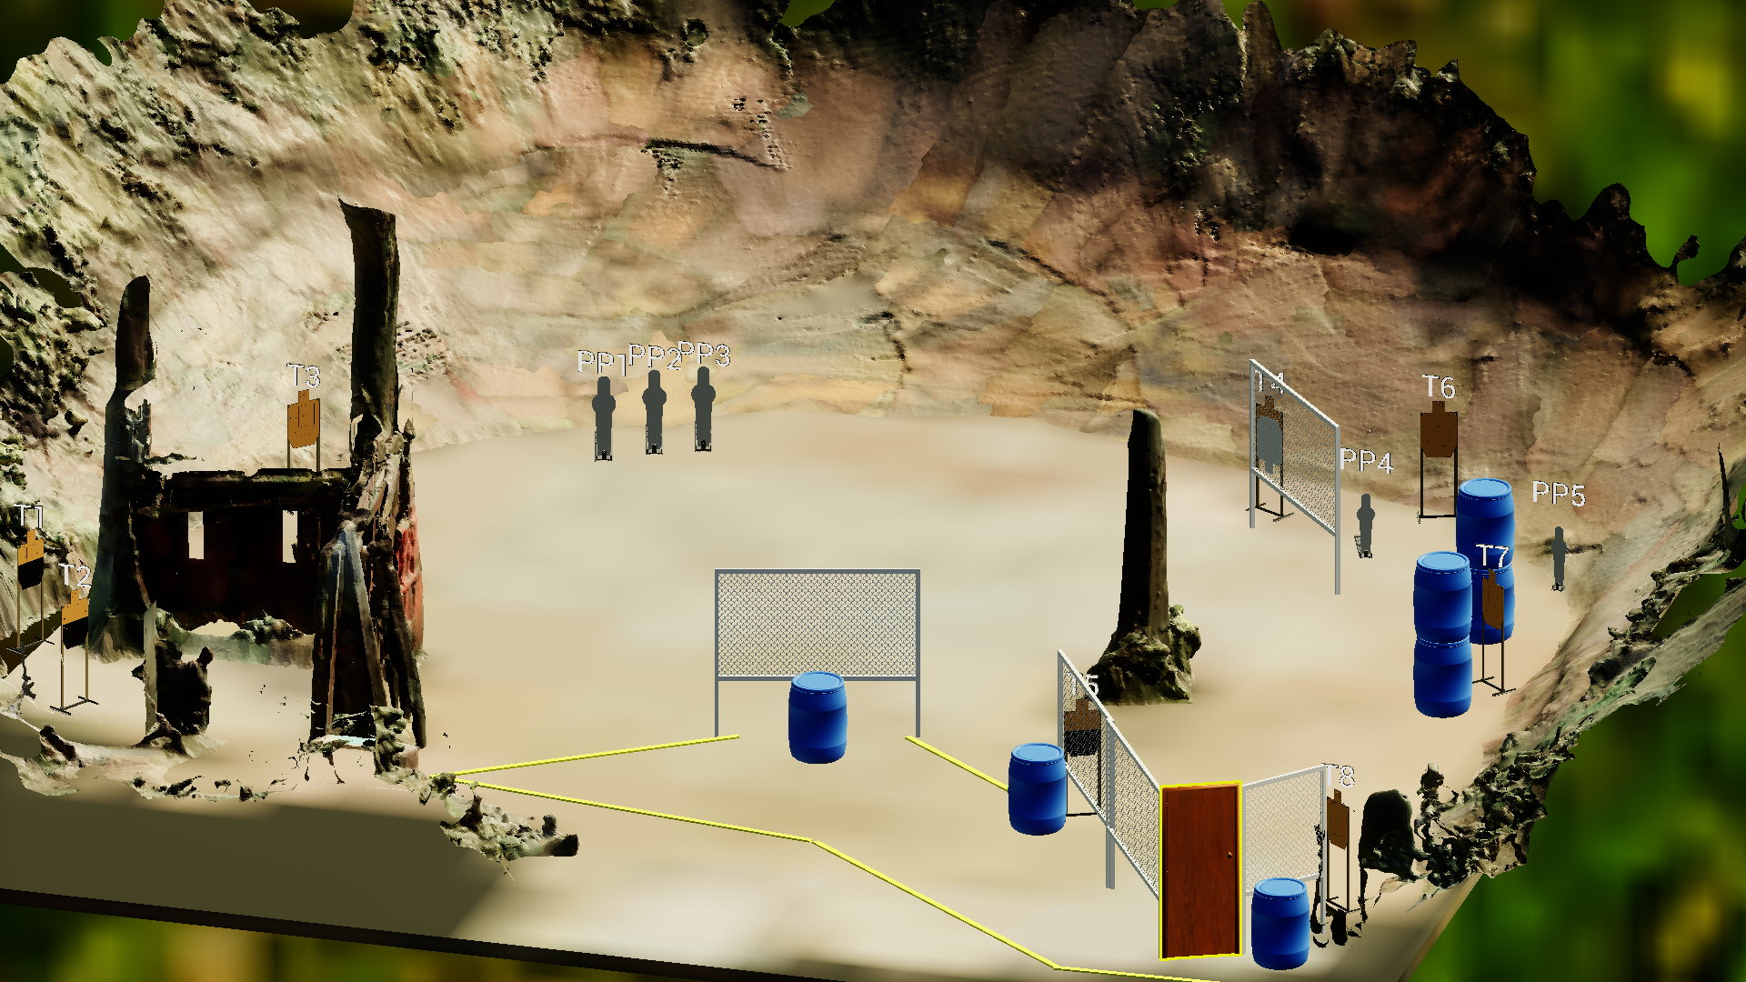
 | Stage 4 Gentle Spartans Course Designer: Jordan Rogers

